Slide 1


User Defined Utilities
Prepared By- Shrish Tripathi

Slide 2
Create separate folder in Project

Slide 3
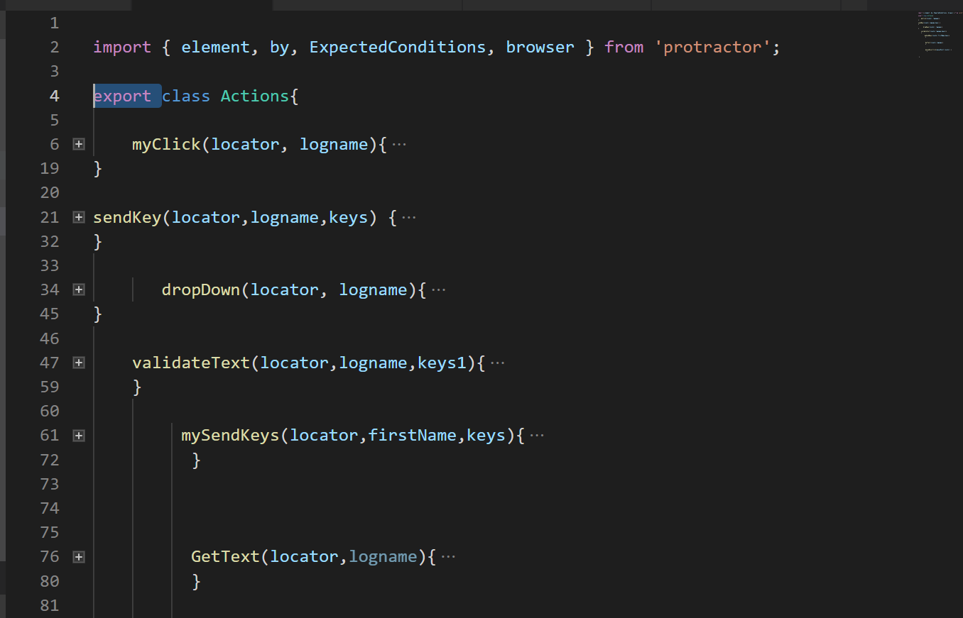

Slide 4
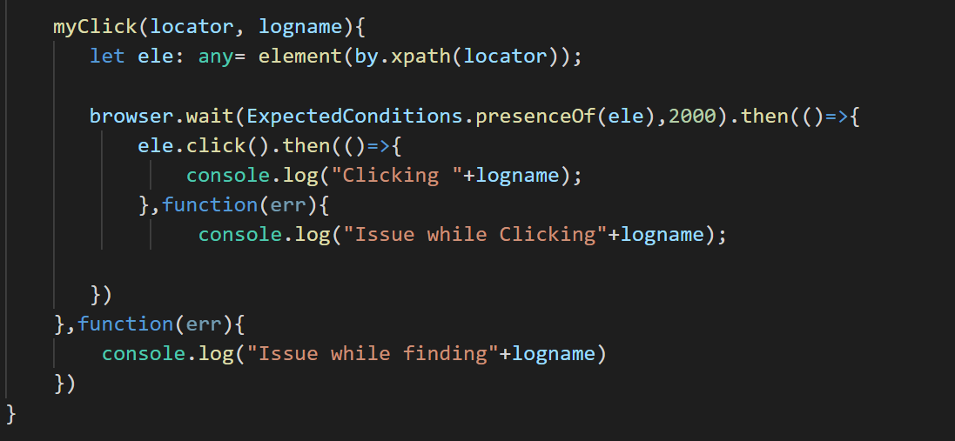
Customize- click

Slide 5
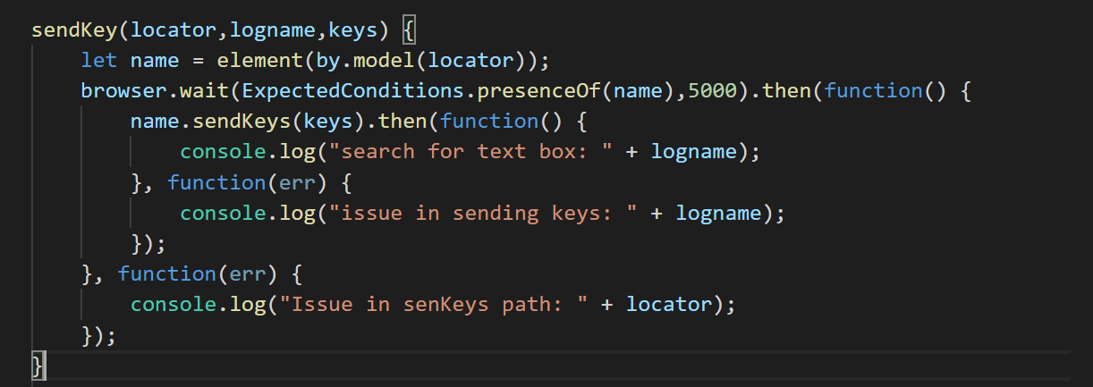
Customize send key

Slide 6
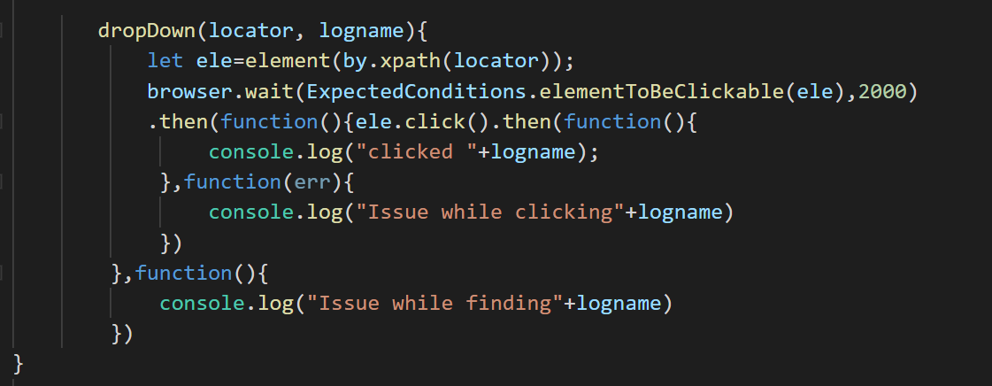
Customize -dropdown

Slide 7
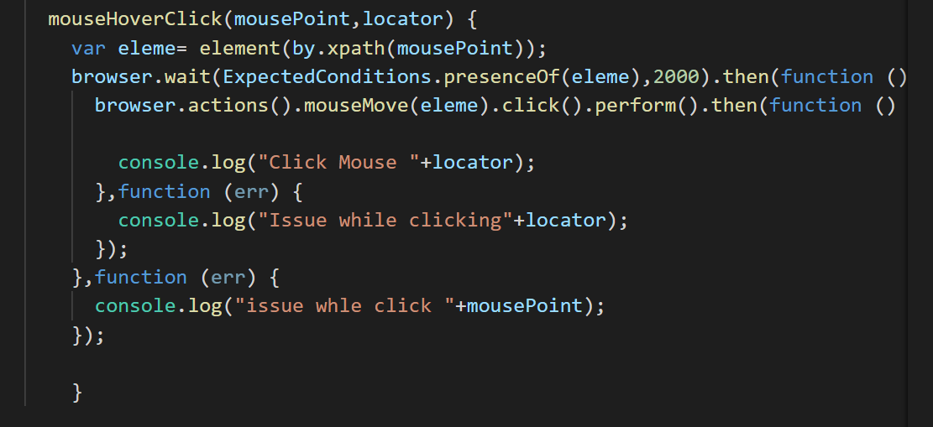
Mouse hover and then click

Slide 8
Let’s create more reusable and robust

Slide 9
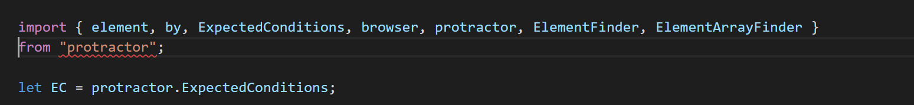

Slide 10
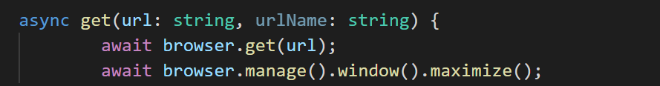

Slide 15
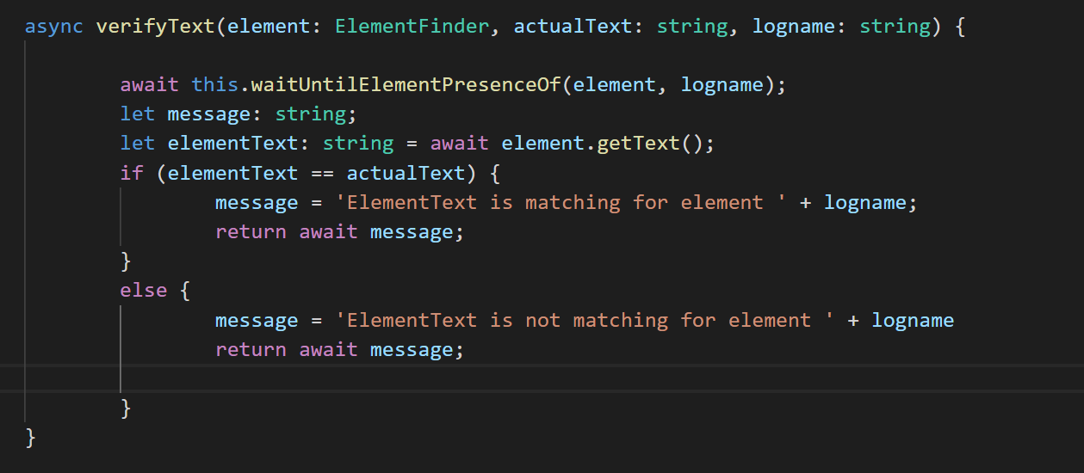

Slide 16
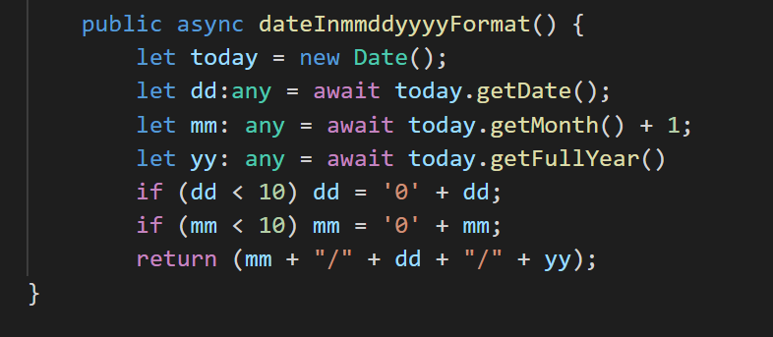

Slide 17
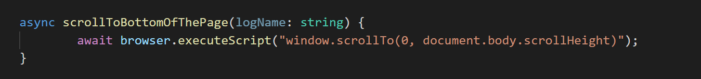

Slide 18
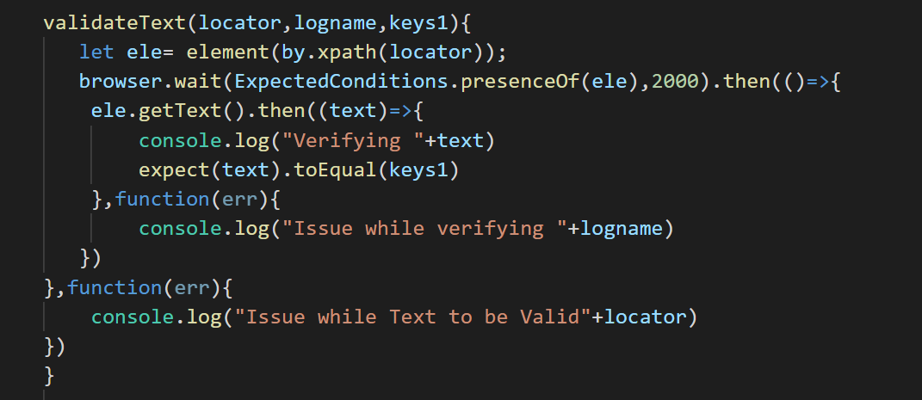

Slide 19
and lot more….. Based on our requirement

